Slide 1
COMP6230
Expect the Unexpected
Oliver Bills
ofb@ecs.soton.ac.uk

Slide 2
D.D.D.D.D.
Dyn DNS DDOS Disrupts Domains
Notes:
Yahoo sucks, cant escape
Yahoo software complicates email
Yahoo scans customer emails

Slide 5
The Internet of Things Craze
Busybox
Useless Manufacturers
Idiots
IoT Botnets
Mirai
Bashlight

Slide 6
L.P.E.V.
Linux Privilege Escalation Vulnerability
Notes:
Yahoo sucks, cant escape
Yahoo software complicates email
Yahoo scans customer emails

Slide 7
Any user can become root in < 5 seconds in my testing, very reliably. Scary stuff.
The vulnerability is easiest exploited with local access to a system such as shell accounts. Less trivially, any web server/application vulnerability which allows the attacker to upload a file to the impacted system and execute it also works.
Notes:
A race condition was found in the way the Linux kernel's memory subsystem handled the copy-on-write (COW) breakage of private read-only memory mappings. An unprivileged local user could use this flaw to gain write access to otherwise read-only memory mappings and thus increase their privileges on the system.

Slide 8
Expect the unexpected
Meet Rob!
You’ll be seeing a lot of him soon
He’s your new lecturer, so I can go to the back of room and sleep…
He also builds systems
And he’s a unicorn
And he’s pink...
I’m going to use him as an illustration
Expect the unexpected
Because the expected is what’s dealt with in all your other modules

Slide 9
What’s coming up
You’ve met Rob, so that’s the important bit done…
We’ll be throwing you in at the deep end
But don’t panic!
A whistle-stop tour of web cybersecurity
And then we’ll let you get your hands dirty
Rob the Shop!

Slide 10
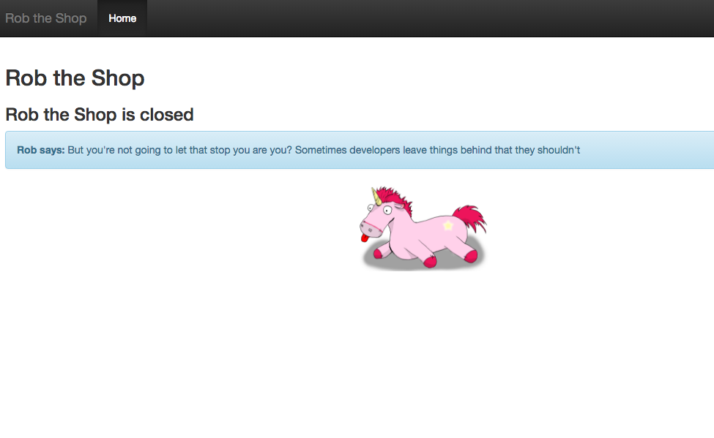
Rob the Shop

Slide 11
What’s coming up
An introduction to web application security
Common web vulnerabilities
Your first hacking

Slide 12
What’s coming up
Today
1pm to 3pm
Introduction lecture
Lab Session
3pm to 5pm
Tutorial
Thursday 12pm
What you’d like me to cover

Slide 13
Here’s your average user of your system
They follow the steps through
Presses the right buttons at the right times
Always puts in the correct information at each stage
Follows the process through from the beginning
Here's the hard truth: They don't exist
“They shouldn’t have pressed that button on that stage”…
Notes:
iSolutions mantra

Slide 14
And then you have your non-average users…
They don't follow any of the steps
They press the worst buttons at the worst possible times
They put the incorrect information at each stage
They ignore any process you've tried to put into place
And they do exist
And sometimes this should be you...
And sometimes it already is…
Notes:
Lloyd

Slide 15
10 years ago…
The web was rife with vulnerabilities!
Websites were constantly being hacked, personal data stolen
Cross-site scripting, SQL injection, poor validation, you name it, it was there!

Slide 16
Fast Forward to the Future
The web is rife with vulnerabilities!
Websites are constantly being hacked, personal data stolen
Cross-site scripting, SQL injection, poor validation, you name it, it was there!

Slide 17
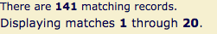
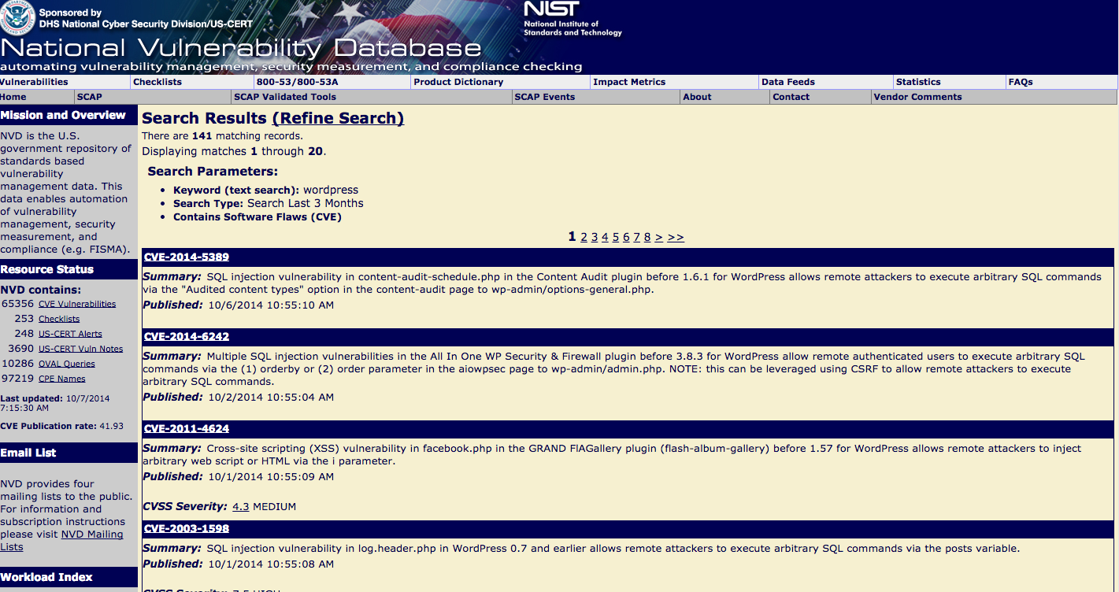
Surely not?
Let’s do a search for vulnerabilities in Wordpress and associated plugins in the last 3 months

Slide 18
Surely the big companies have learnt their lesson by now?
You probably already know that they don't!
I have a policy of setting up companyname@mydomain when I register at a site
If I ever get spam to that email, I know who gave away my email
So who has...?

Slide 19
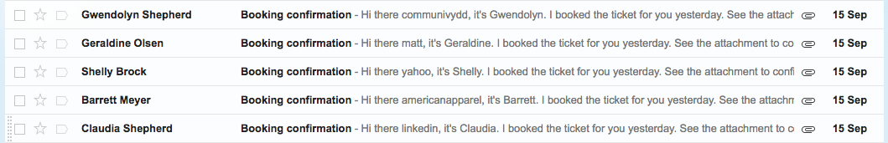
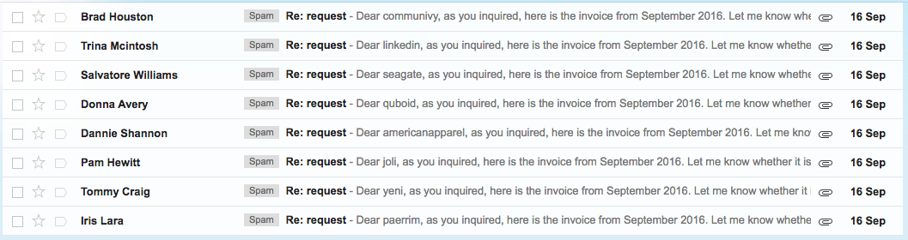
When I get spam, I get lots of spam

Slide 20
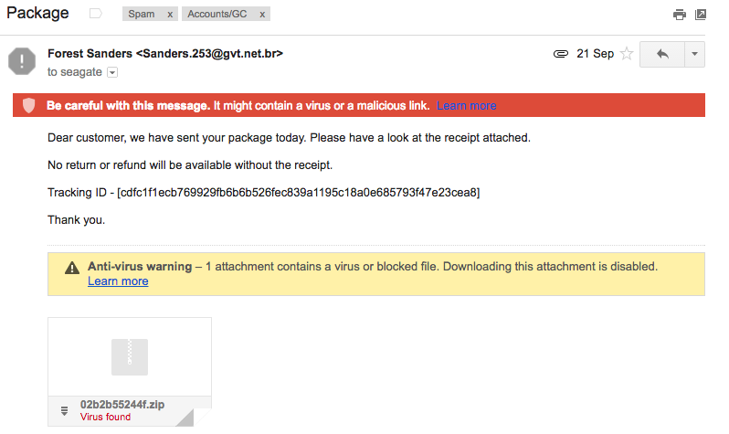
And I know who to blame…

Slide 21
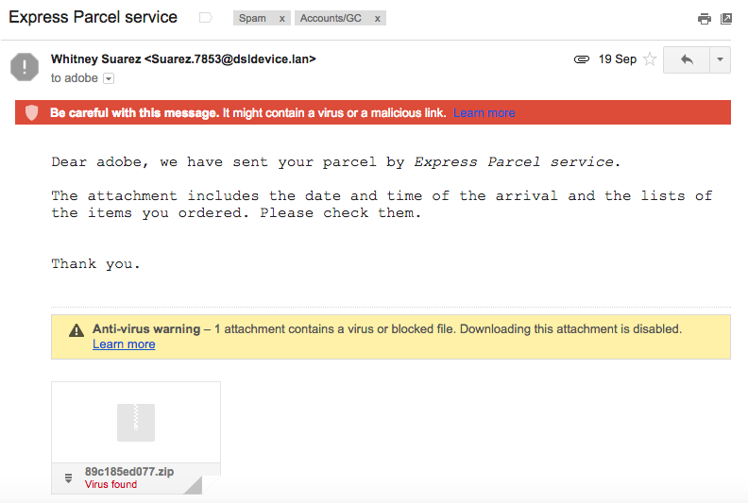
And I know who to blame…

Slide 22
Let’s take a look at just a few
Yahoo (new this year!)
Adobe
Dropbox
LinkedIn
HP
Seagate
LastFM
Backupify
The university

Slide 23
Let’s take a look at just a few
Yahoo (new this year!)
Adobe
Dropbox
LinkedIn
HP
Seagate
LastFM
Backupify

Slide 24
So nothing has really changed…
Our only hope is you!
Be aware of the security vulnerabilities
Write secure code
Test your applications
Don't get hacked
Don't let your friends get hacked

Slide 25
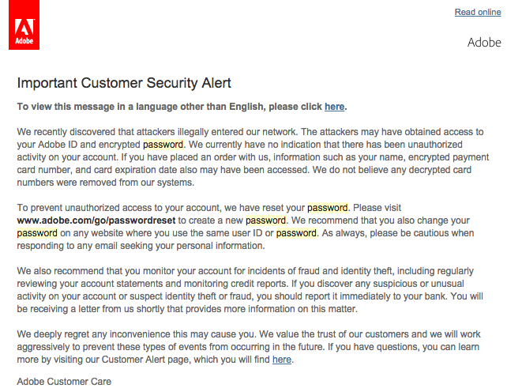
And avoid having to send out something like this… (it’s embarassing)

Slide 26
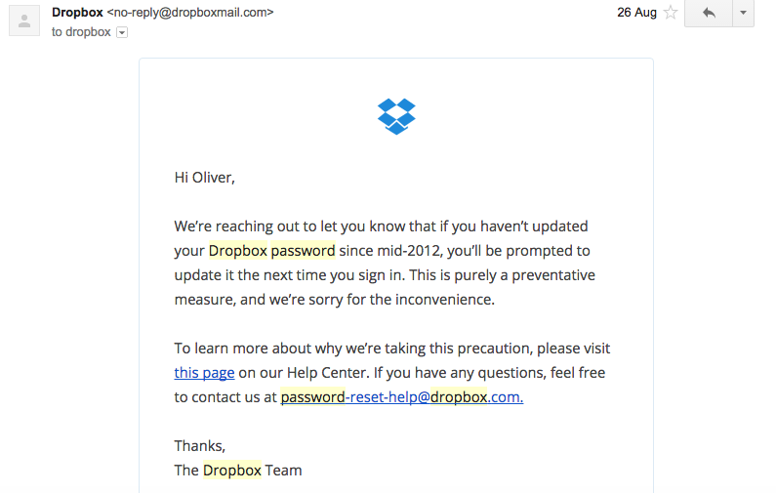
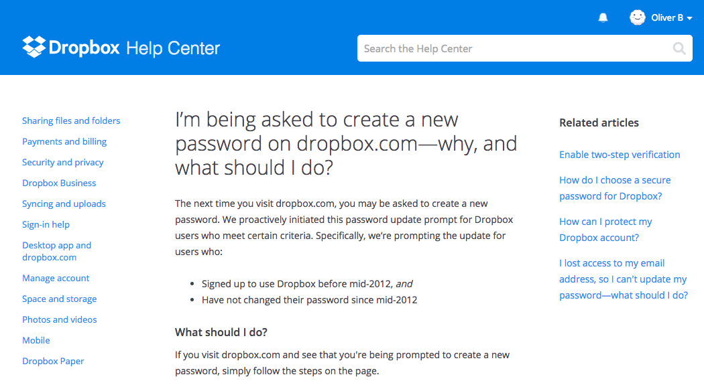
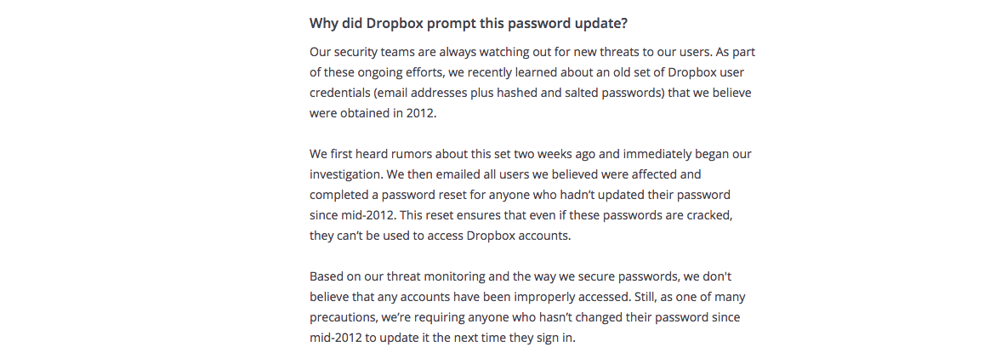
Or just try and hope that people don’t notice and read the link…

Slide 27
So without further ado
We’re going to look at some of the most common vulnerabilities
To start with, a quick run through to introduce the ideas
We’ll go through in more detail in the next lectures!
We’re going to have a go at exploiting them

Slide 28
What vulnerabilities can you think of?

